Slide 1
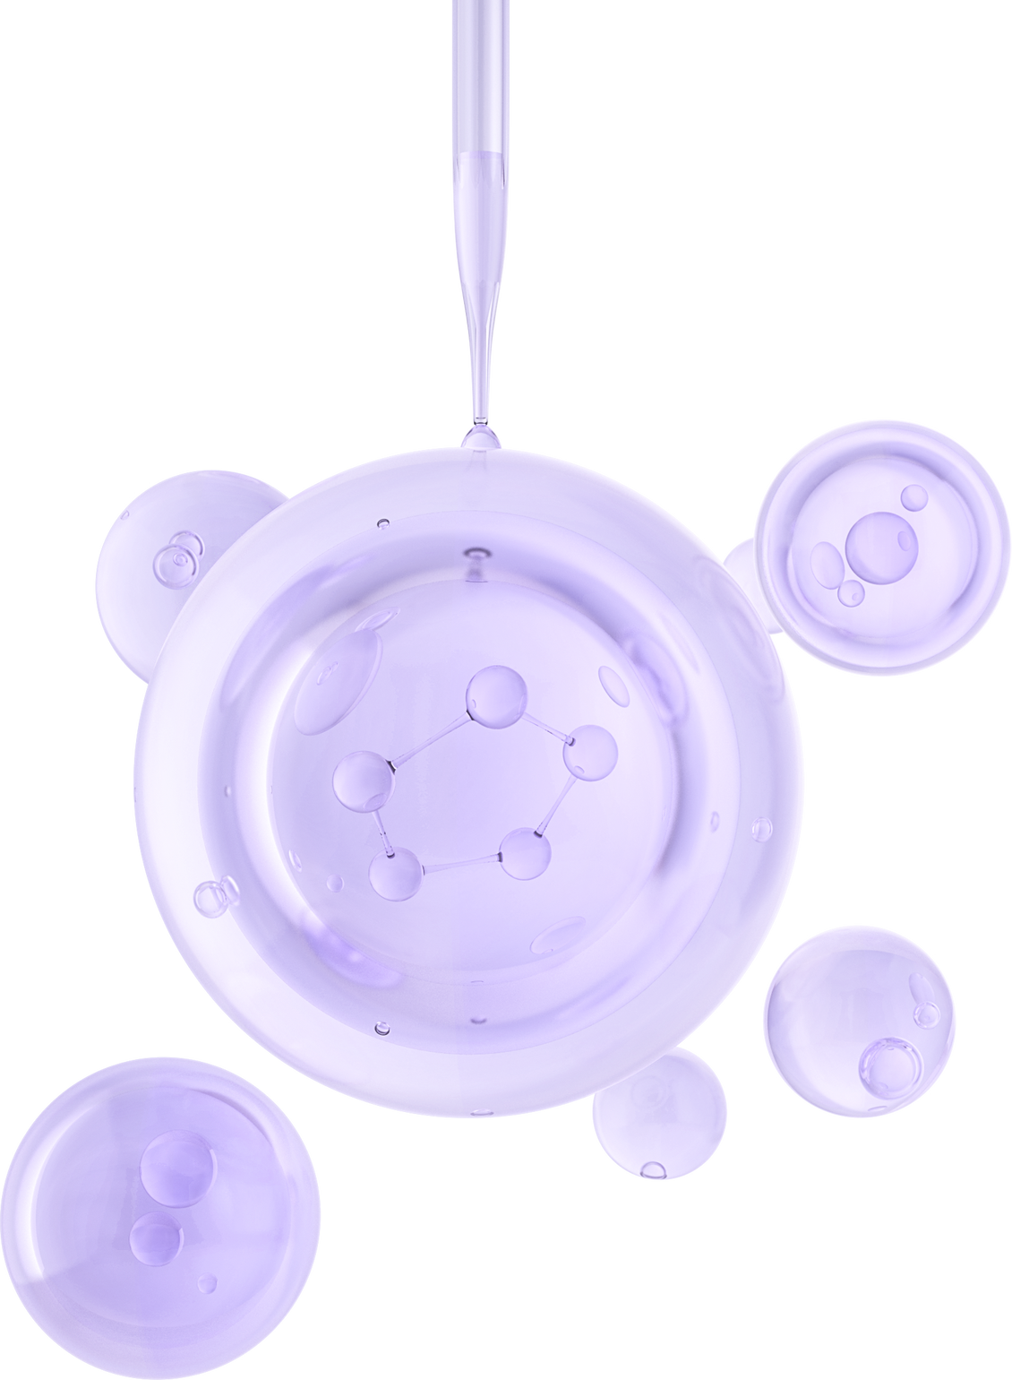
AI INNOVATION 3.0
APRIL 28, 2024
PROBLEM STATEMENT-2
HISTOLOGY-NET
Self-Supervised Segmentation Solver
Team 32-B:
Dhruv, Uthamkumar M, Shashank Dwivedi,
Paras Bedi, Riya Arora

Slide 2
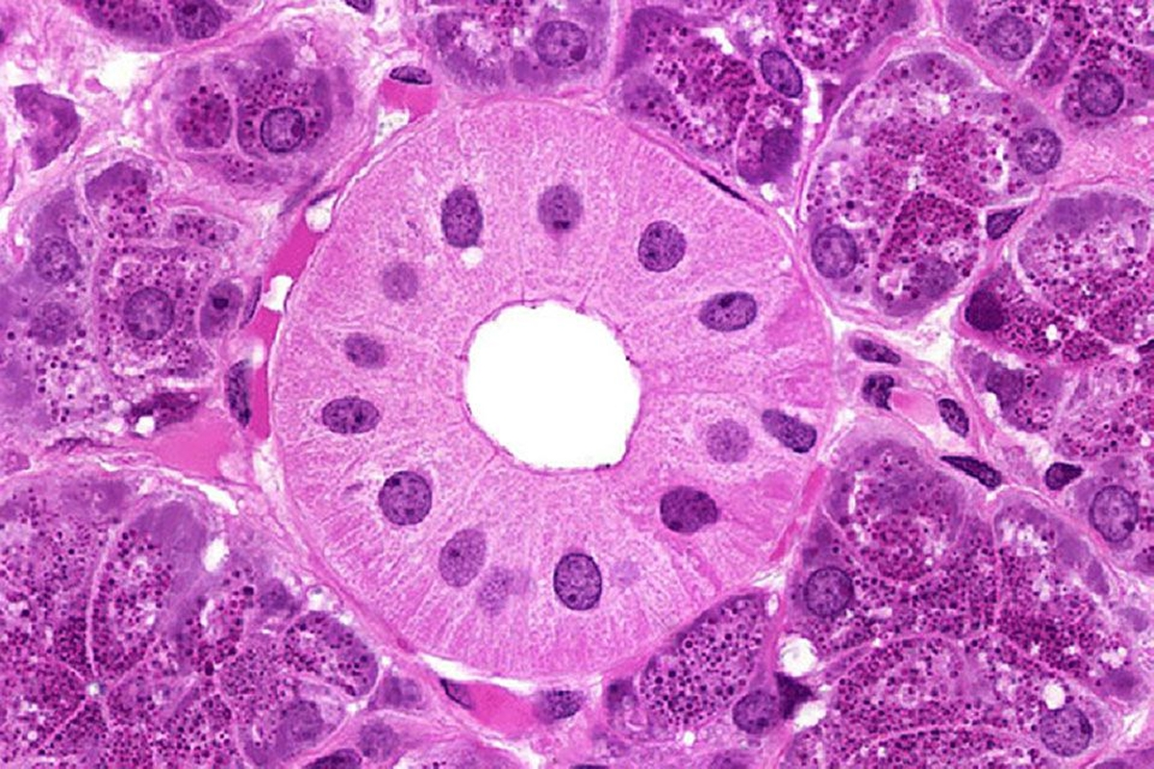
Problem Statement
This project aims to develop a self-supervised learning model for efficient binary segmentation of histology images, with little labelled data and abundant unlabelled data; and integrate it into a user-friendly webpage for practical utility.

Slide 3
Tasks
Choose and implement appropriate pre-text task(s) to facilitate self-supervised learning from the unlabeled histology image dataset.
Create a user-friendly webpage that deploys the model and generates segmented masks to the user-input histology images .
Segmentation & Inference
Pre-Text Training
User Friendly Webpage
Develop the self-supervised learning model by fine-tuning on labelled data, capable of segmenting histology images into meaningful regions.

Slide 4
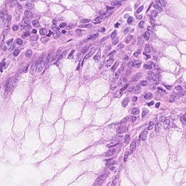
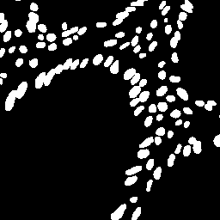
Dataset
1
Image data with and without segmentation masks.
Image
Segmentation Mask
2
3842 unlabeled images and 640 labeled images
3
RGB images with size 256*256*3
4
Grayscale labels with size 256*256*1

Slide 5
Trial Models
(Baseline Model)
A U-net based customised Encoder-Decoder model pre trained with various pretext conditions
Test Scores:
Dice Coefficient: 0.81, Jaccard Index: 0.70
Inference Time:
50 seconds/100 images

Slide 6
Trial Models
(Two Sequential U-Net models)
While analysing the output produced by a standalone model, we inferred that there are a lot of tiny noise patches.
So, another U-Net architecure based model was trained to learn these tiny patches and remove them.
Validation Scores:
Dice Coefficient: 0.83, Jaccard Index: 0.72

Slide 7
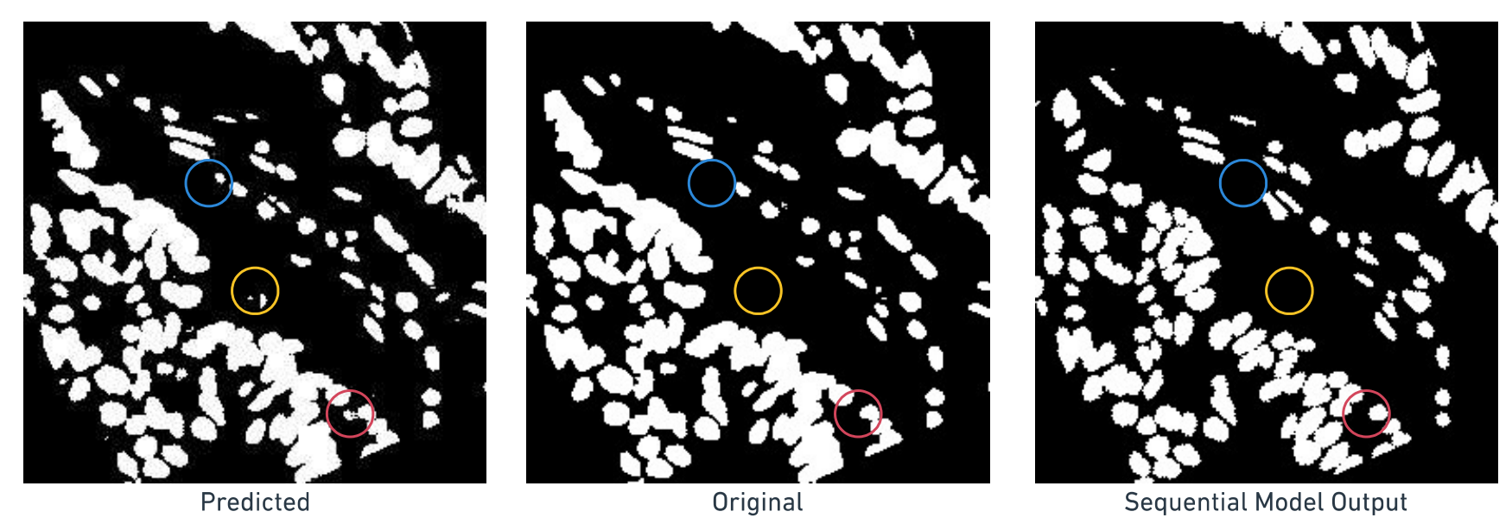
Trial Models
(Two Sequential U-Net models - Visualizing the Outputs)

Slide 8
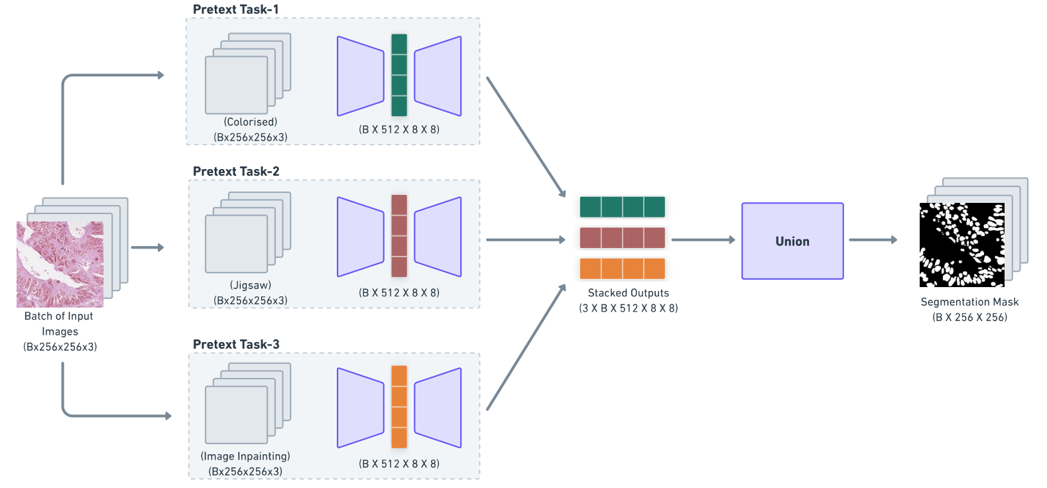
Model Innovation

Slide 9
Model Innovation
We did multiple pretext training to maximise the power of self supervision.
Validation Scores:
Dice Coefficient: 0.83864, Jaccard Index: 0.723053
On applying the previous sequential model to this,
Validation Scores:
Dice Coefficient: 0.83888, Jaccard Index: 0.723393
Further Work:
Rather than using union in the last layer to concatenate the outputs, we can use a U-Net model that tries to learn the weightage for each of the pretext model outputs

Slide 10
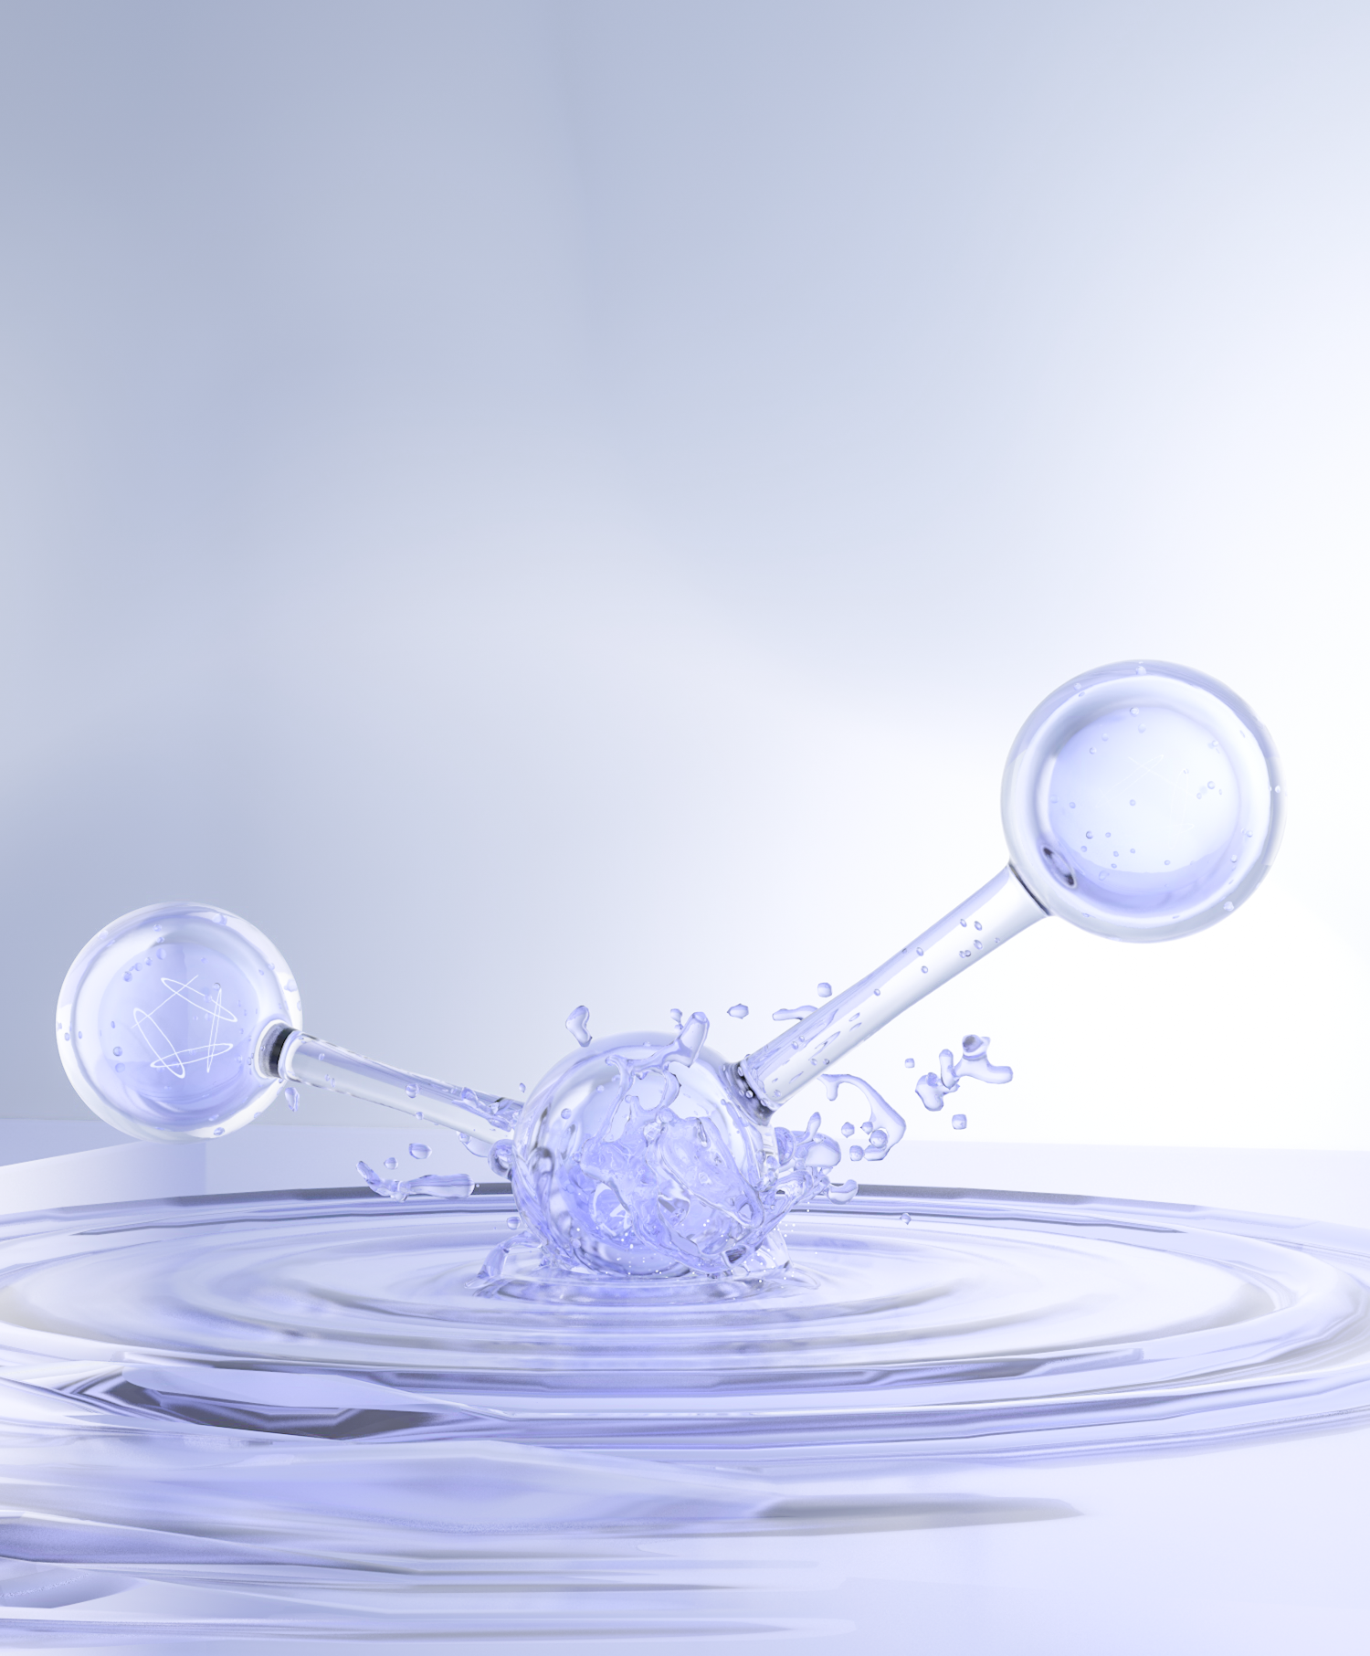
WebApp Demo
https://histonet.streamlit.app/

Slide 11
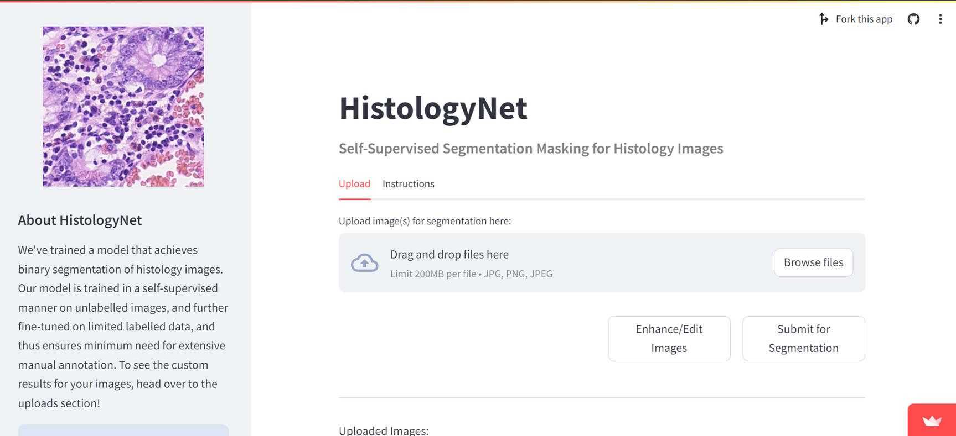
WebApp Demo

Slide 12
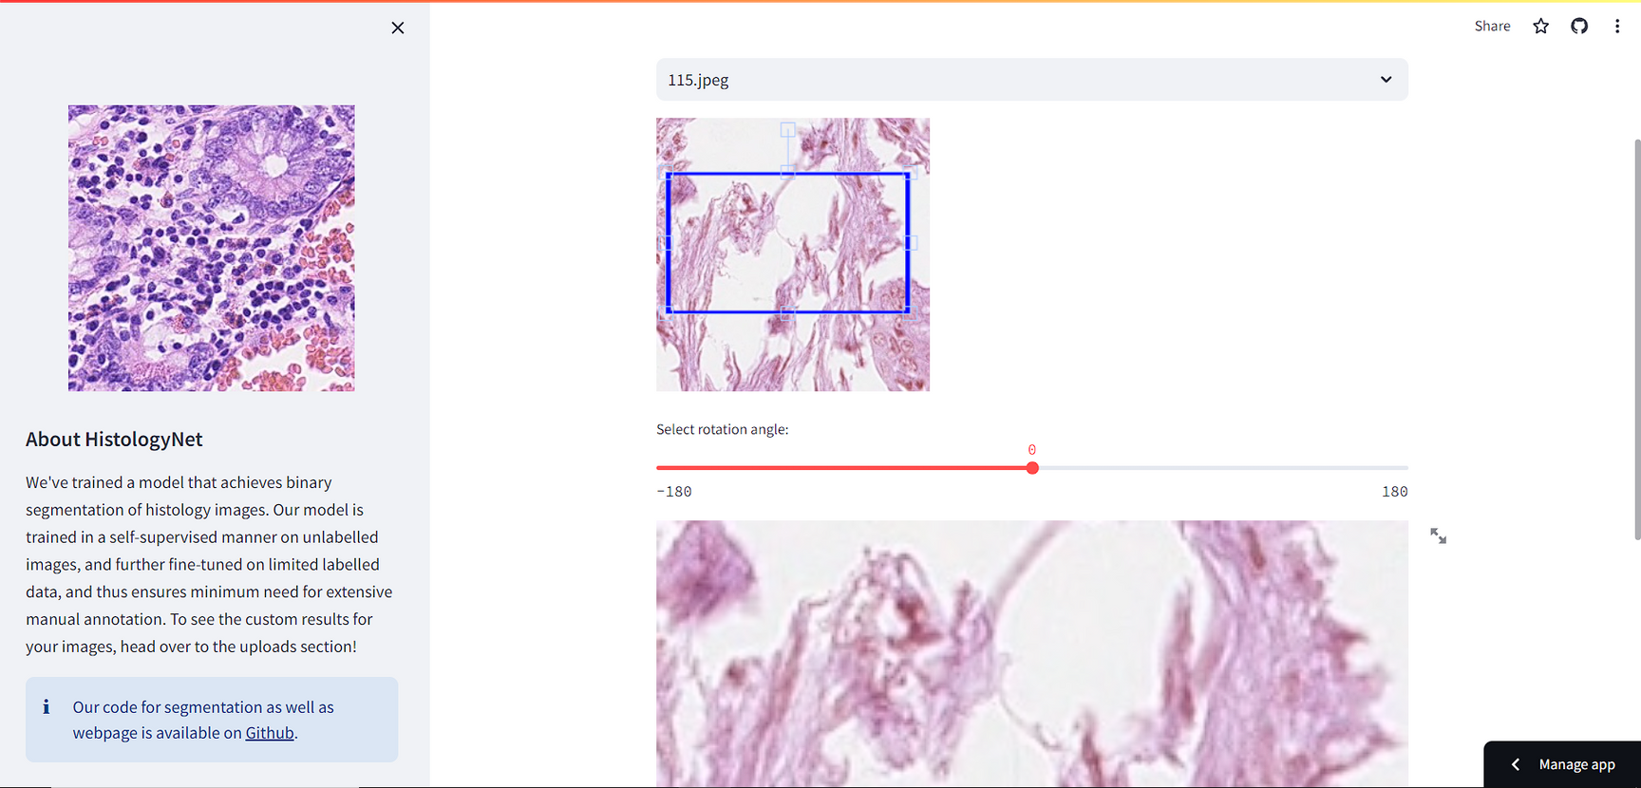
WebApp Demo

Slide 13
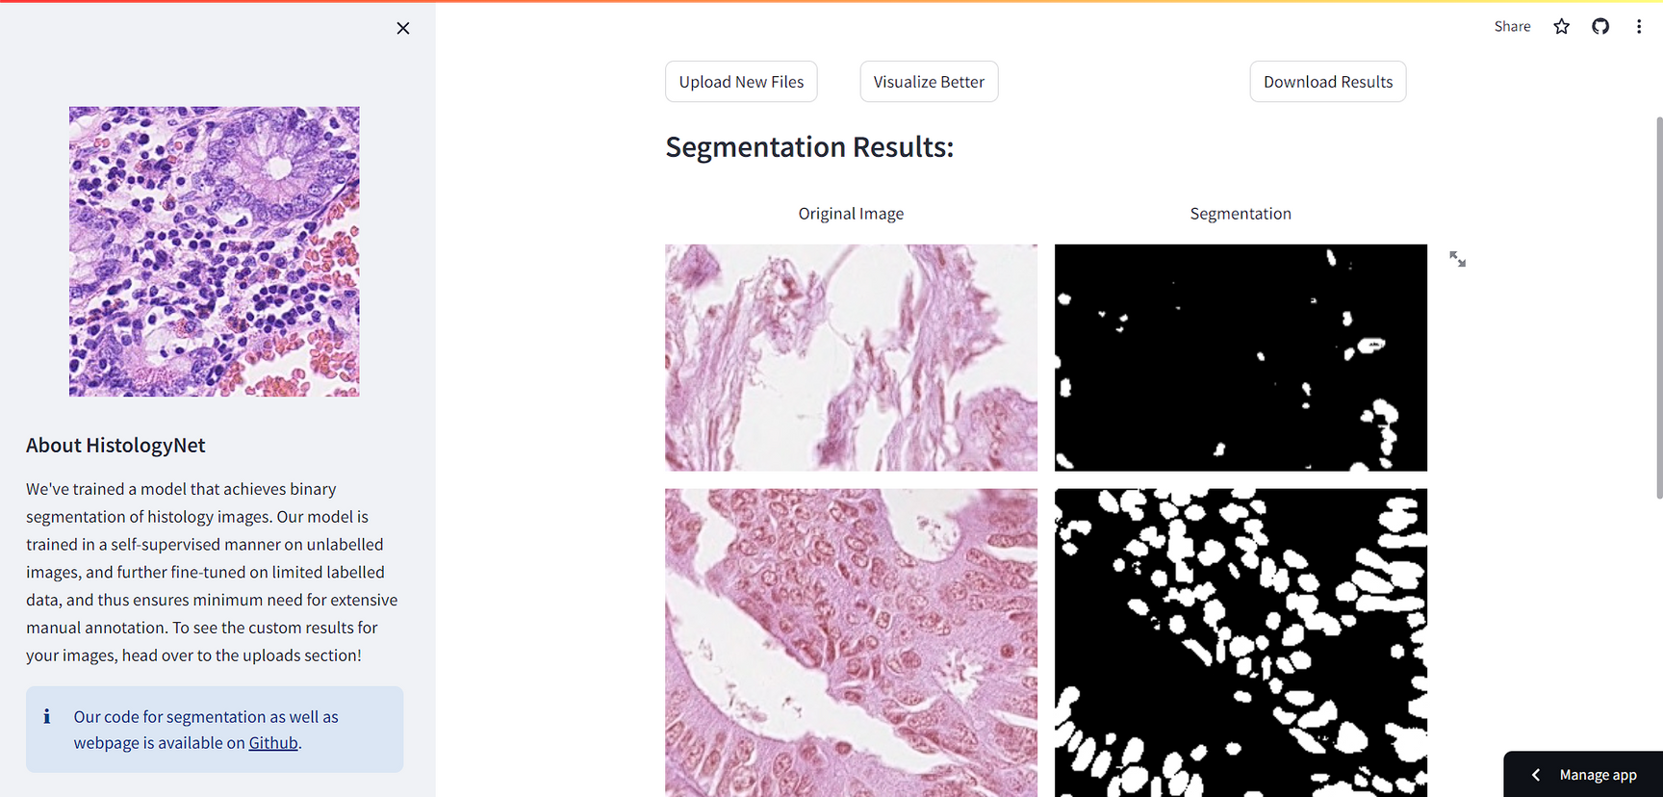
WebApp Demo

Slide 14

Thank You!

